Slide 1



SECURE
MESSAGE
TRANSMISSION

Slide 2

OVERVIEW
Secure message transmission ensures the confidentiality, integrity, and authenticity of messages exchanged between parties.
Key Objectives:
Protect sensitive data from unauthorized access and interception.
Verify the authenticity of the sender and ensure the integrity of the transmitted message.
Importance:
Critical in various sectors such as finance, healthcare, and personal communications.
Helps maintain trust in digital communication channels amidst rising cyber threats.

Slide 3



RSA ENCRYPTION
RSA Algorithm:
A widely used public-key cryptosystem for encrypting messages, providing a robust framework for secure communication.
Key Components:
Public Key: Used to encrypt messages, making them accessible only to the intended recipient.
Private Key: Used to decrypt messages, ensuring that only the owner of the private key can access the original content.
Security Basis:
Relies on the mathematical difficulty of factoring large prime numbers, making it computationally infeasible for attackers to derive the private key from the public key .
Operational Example:
The recipient generates a public-private key pair. The sender uses the recipient's public key to encrypt the message, ensuring that only the recipient can decrypt it using their private key .

Slide 4


MESSAGE AUTHENTICATION
Digital Signature:
A unique signature generated by the sender's private key, attached to the message.
Purpose:
Confirms Message Integrity: Assures the message remains unchanged.
Ensures Authenticity: Verifies the sender's identity.
Verification:
The recipient uses the sender's public key to validate the signature, ensuring the message's authenticity and integrity.
Benefits:
Builds trust in digital communications by preventing forgery and unauthorized access.

Slide 5



RISK ASSESSMENT
Feature Extraction:
Analyzes key transmission metrics, including message length, encryption time, and network activity.
Risk Classification:
Employs a Random Forest Classifier to evaluate and predict the security status of message transmissions.
Objective:
Enhances security by identifying and flagging potential threats, providing proactive protection against vulnerabilities.
Outcome:
Contributes to a more secure messaging environment through predictive analytics and automated risk assessments.

Slide 6

MODULES OF THE SYSTEM
User Interface:
A user-friendly web platform that allows message input and initiates the encryption process.
Key Management:
Generates and manages RSA public-private key pairs for secure encryption and decryption.
Encryption Module:
Encrypts messages using the recipient’s public key, ensuring only the intended recipient can decrypt.
Signing Module:
Signs the encrypted message with the sender’s private key, ensuring message integrity and authenticity.
Machine Learning Module:
Analyzes transmission data, identifying security risks using a trained Random Forest Classifier.
Decryption Module:
Decrypts the message only if the transmission is classified as secure, using the recipient’s private key.

Slide 7
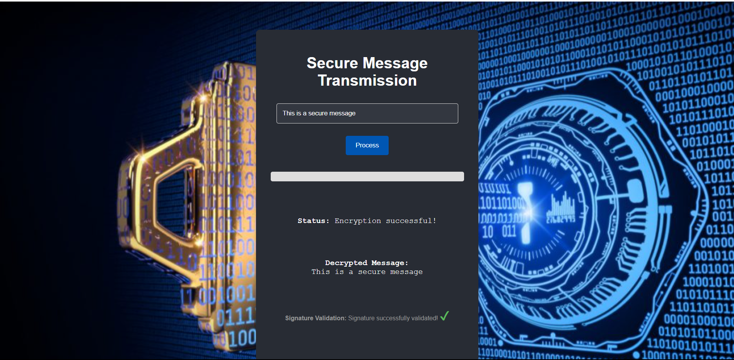
SYSTEM IMPLEMENTATION
Backend:
Developed in Python, integrating pycryptodome for robust RSA encryption and scikit-learn for machine learning-based risk analysis.
Frontend:
A simple and intuitive web interface designed with HTML, CSS, and JavaScript, enabling users to securely input and transmit messages.
Machine Learning Model:
Trained on a well-curated dataset to accurately classify transmissions as secure or risky, enhancing overall system security.

Slide 8
SUMMARY &
FUTURE SCOPE
Summary:
The system integrates RSA encryption for secure communication, digital signatures for message integrity, and machine learning for assessing transmission risks, providing a multi-layered defense against security threats.
Future Scope:
Advanced Encryption: Investigating stronger encryption techniques, such as post-quantum cryptography, for enhanced resilience.
Improved Machine Learning: Incorporating more sophisticated algorithms to improve threat detection accuracy and adapt to evolving security challenges.

Slide 9
THANK
YOU!

